Slide 1



Task Management Software
Presentation by:
Akshyarika Moharana
Deepika Adireddi
Monalisa Mondal
Rujitha Gollapudi
Charishma Nukala

Slide 2
Overview
The project Task Management Software aims to perform assign tasks to certain users.
The TMS should perform Create,Read,Update,Write operations on both tasks&users.
The Users can register or login through an existing account and view or update the details.

Slide 3

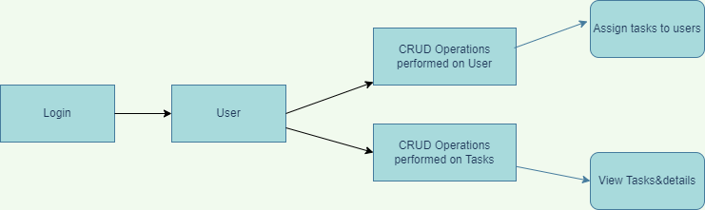
Design Architecture
User can register or login to this software.
Once the user logs in the system,the user will have access to create the tasks and view the task details and deadline also.

Slide 4
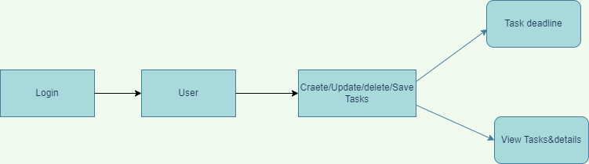
F
Architecture for task
User can login to the existing account and check the task details and deadlines.
User can update the task details and save the task record.

Slide 5
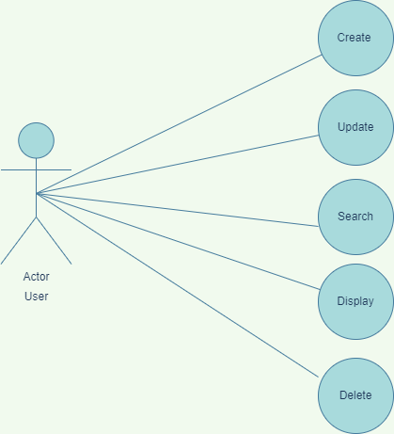
Architecture for User
User can perform create,update,search,delete records .

Slide 6

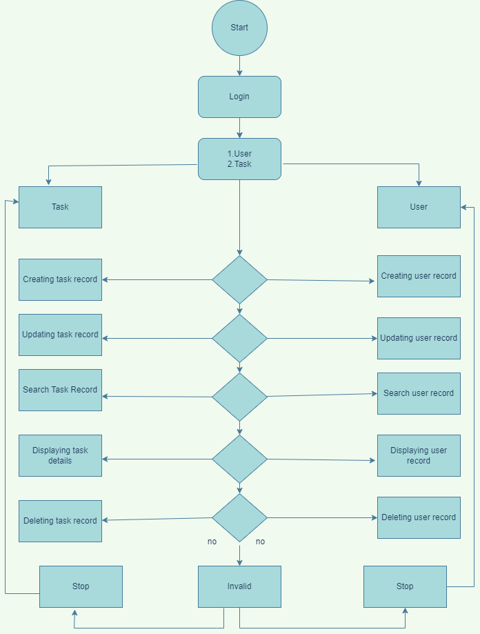

Slide 7
Tools
Ubuntu Linux as platform.
C language.
Draw io is used for pictorial representations.
Makefile is use for compilation.
Gcov is used to check code coverage.
Valgrind to find memory leaks.
Splint is used for static analysis.
GCC is an optimizing compiler.

Slide 8
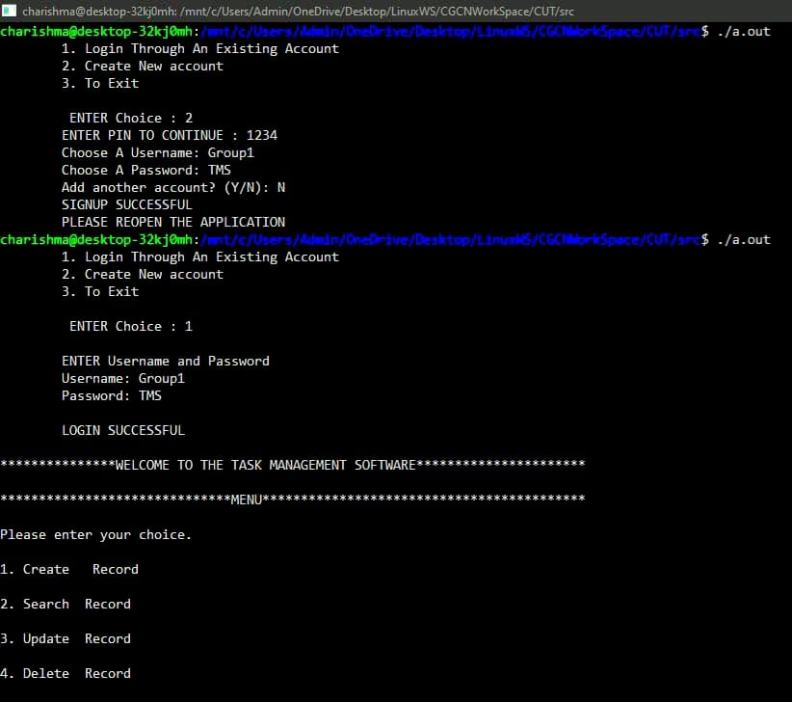
Outputs
Output for Successful Login

Slide 9
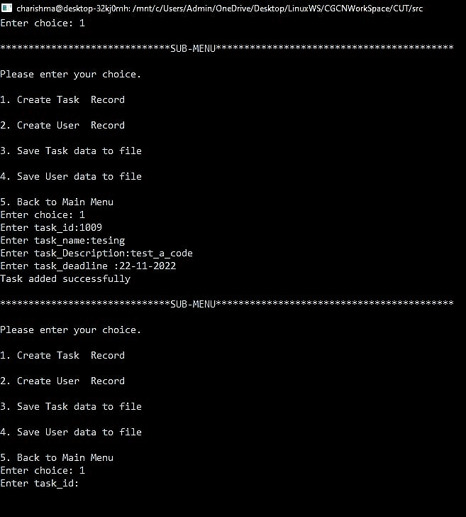
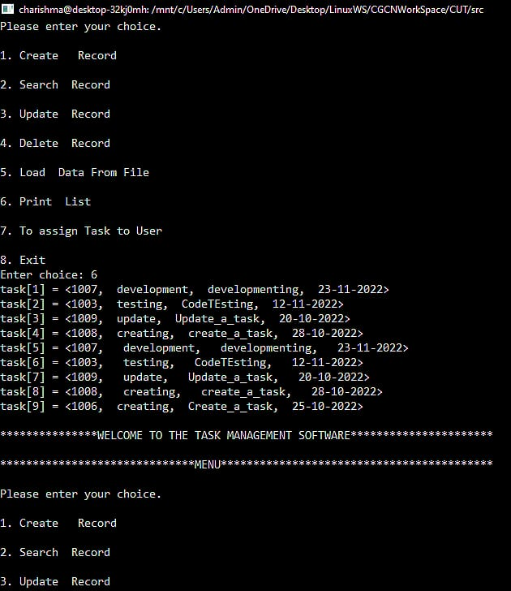
CRUD Operations for User and Task
Output displayed based on Users choice

Slide 10
Challenges
Monalisa Mondal : Understanding SRS
Deepika Adireddi : UT_IT
Charishma Nukala : Design & tools
Akshyarika Moharana : Coding & tools
Rujitha Gollapudi : MakeFile

Slide 11
Thank You

